Slide 1
Wildland Fires in the USA
Data Science and Machine Learning
Tiran Spierer
Ben Israel Siton

Slide 2
Table of Contents
Overview
Research
Data Acquisition
Data Cleaning
EDA
Machine Learning

Slide 3



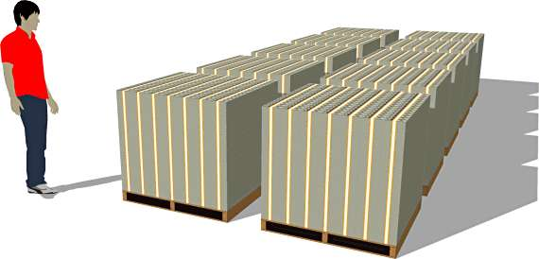
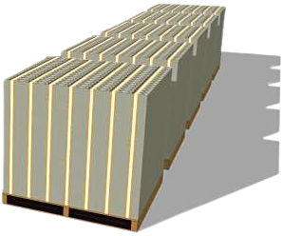

Overview
Research of Wildfires in the US
Average of 62k wildfires per year
Average of 30k km² burned per year
Average annual cost of $1.6B
Average annual death toll of 3,500 humans

Slide 4



Research Questions
Is it possible to predict the size of the next wildfire at a given location?
Is it possible to determine the cause of a wildfire and do wildfires with similar attributes have the same cause?

Slide 5
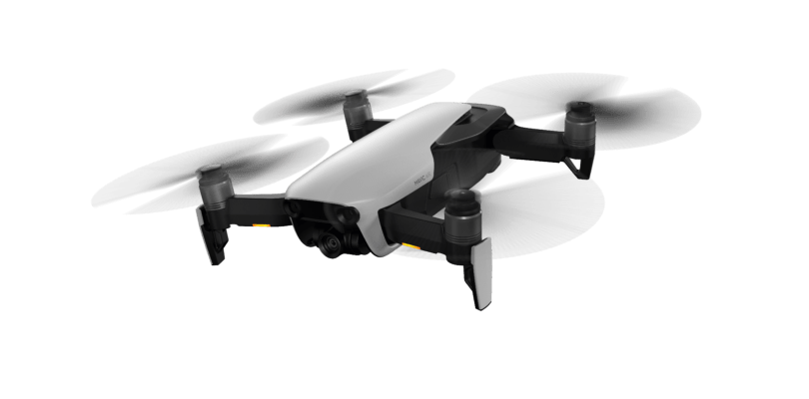
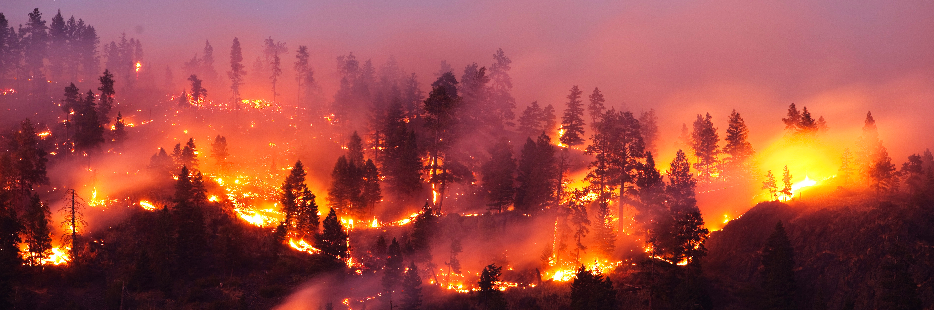
Data Acquisition

Slide 6

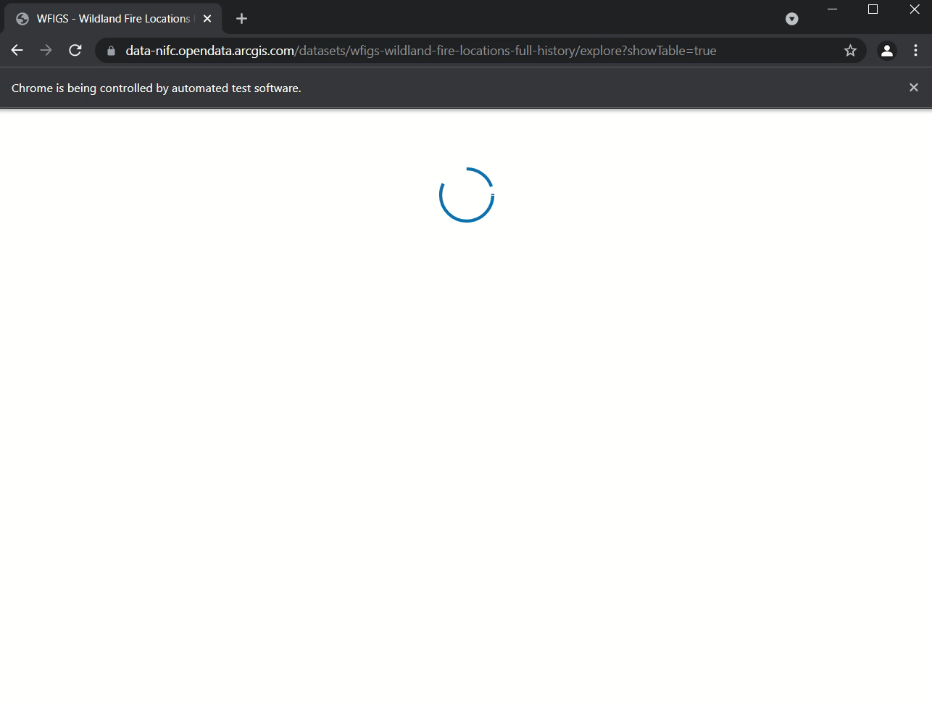

Data Acquisition
Wildfires Data - Crawling
We downloaded a dataset with historical wildfires data. Then, we used automation and crawling to scrape recent wildfires data and add it to the existing dataset.
Selenium driver will sort and scroll down the date table until it finds the most recent wildfire in the existing dataset using a unique ID and then we scrape it.

Slide 7
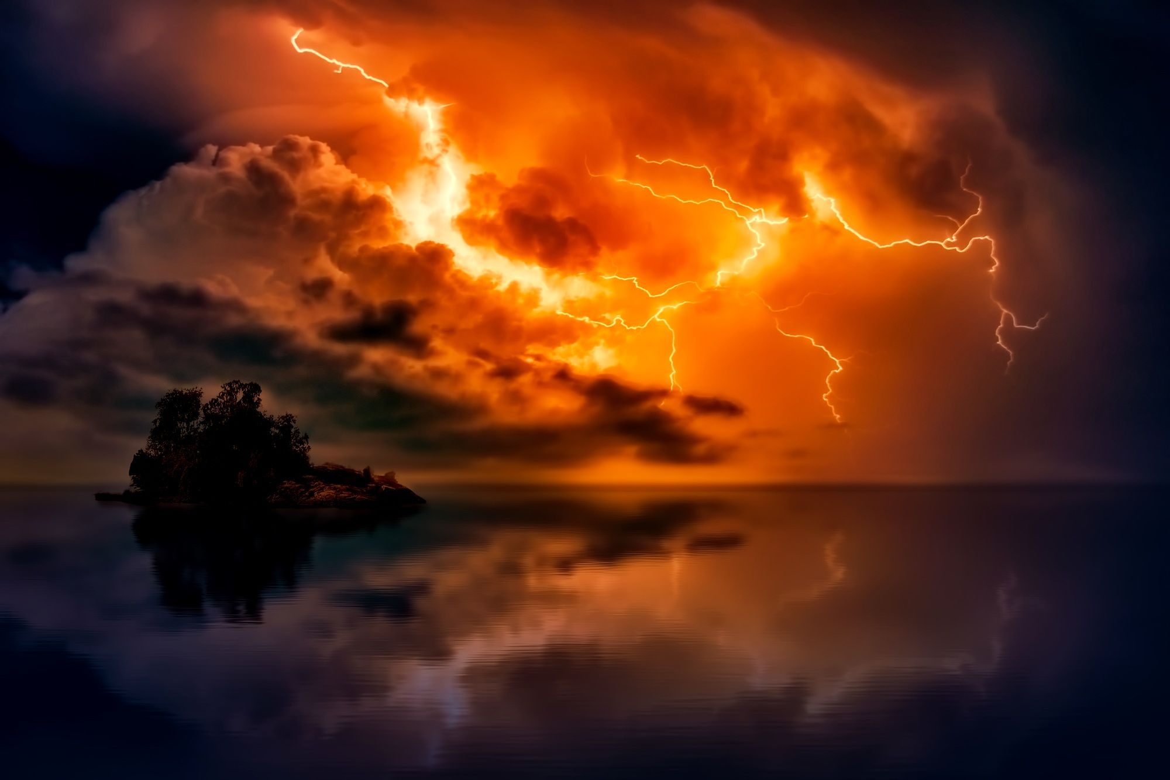


Data Acquisition
Weather Data - API
To gather historic weather data on the wildfires, we used ‘Visual Crossing API’.
It is the only platform we found that allowed access to historic weather data without paying hundreds of dollars.
To gather the weather forecast for the Machine Learning algorithms we used ‘Weather API’.

Slide 8

Data Cleaning

Slide 9
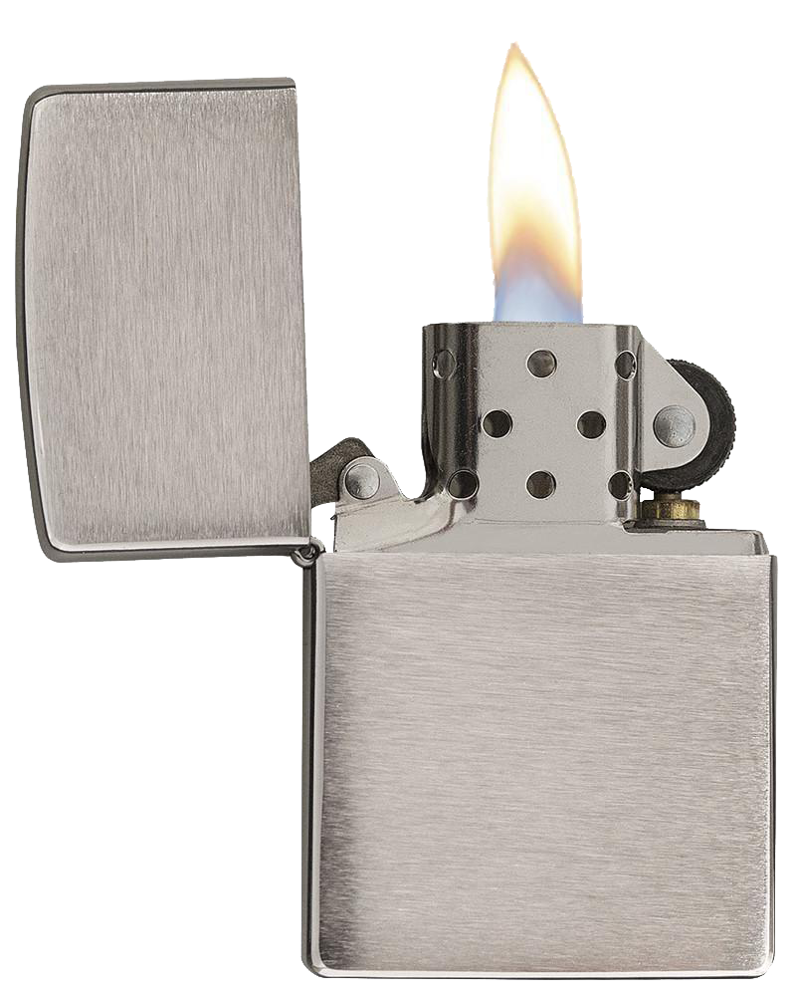

Data Cleaning
Merging and Formating
Merge crawled and downloaded data
mm/dd/yyyy, h:m AM
yyyy/mm/dd, hh:mm
Remove
duplicated fires by ID
Column Label
ColumnLabel
Resolve different formats in crawled and downloaded data
“unknown cause”
“undetermined cause”

Slide 10
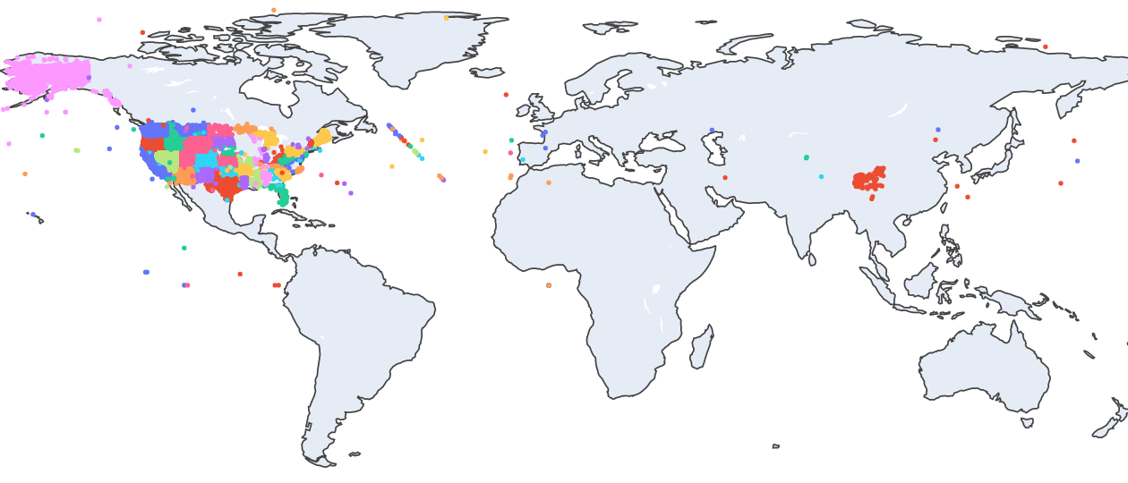
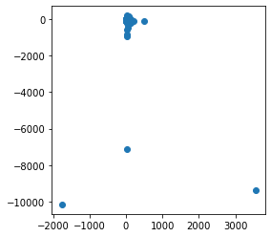
Data Cleaning
Filtering
Many coordinates in the dataset were not inside the United States.
The colors indicate what fire belongs to which state.
We used the ‘reverse_geocoder’ library, a wrapper to Google’s ‘Geocoding API’, to filter the wildfires.
Other coordinates were outliers and not in the valid range, Therefore they were removed.
The valid range is:
-90 to 90 for latitude
-180 to 180 for longitude

Slide 11
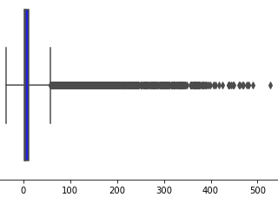
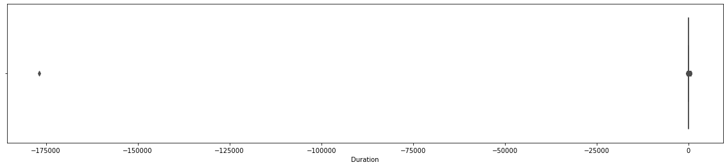
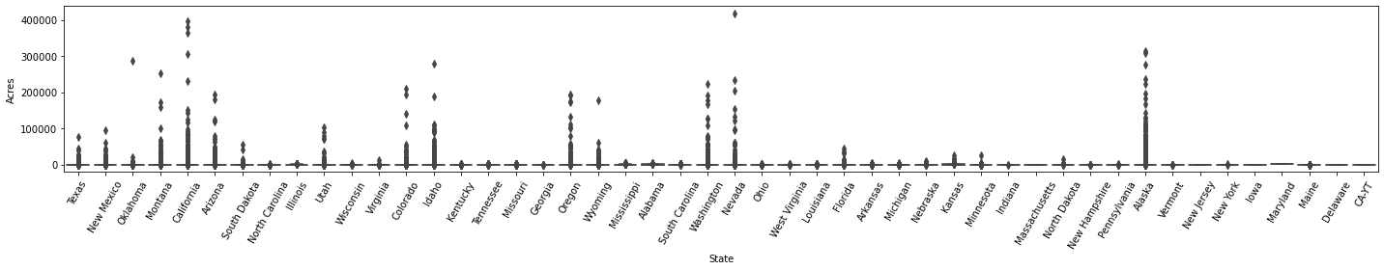
Data Cleaning
Boxplot of duration of fires
Outliers
Duration Outliers
Some fires had a negative duration, for instance the dot on the left-side is a fire which started in 2020 and ended at 1540.
Most fires last less than a day.
We kept the wildfires with a duration over 15 minutes.
Size Outliers
Here we can see boxplots of the fire surface area in each state. The fires on the top have the same area as London.
We kept the wildfires with an area between 1 and 5000 acres.
Duration of fire in days
Boxplots of the size of fires for each state
Size
(Acres)
State

Slide 12
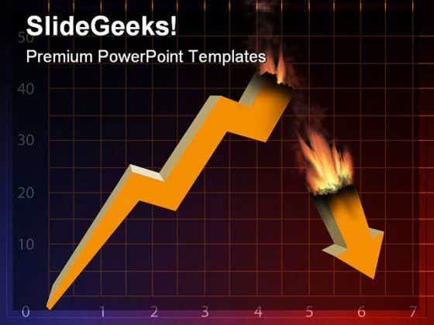
Exploratory Data Analysis

Slide 13
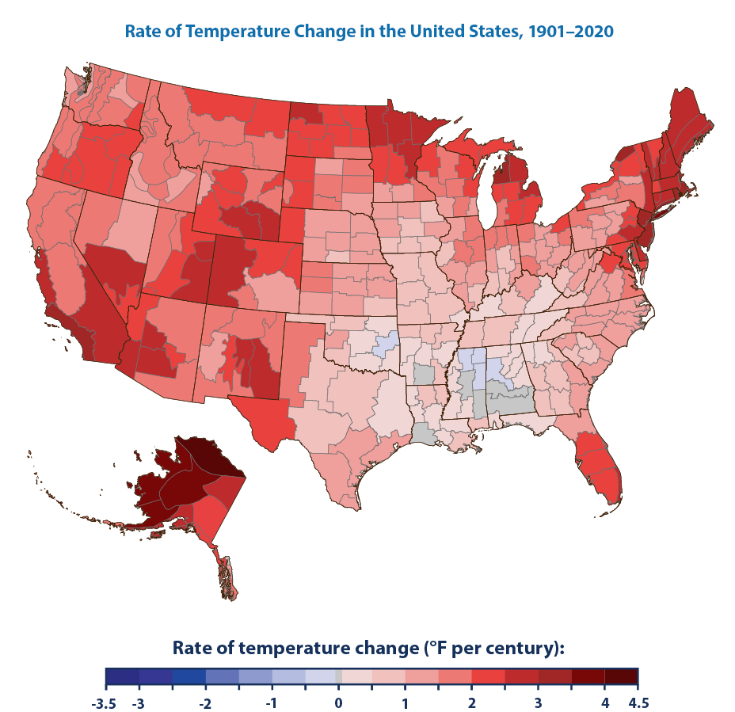
Exploratory Data Analysis
Wildfires and Temperature
On the left we can see that the west side of the U.S got significantly hotter in the past century (according to climate change data).
On the right we have wildfires color-coded by the temperature of their first day.
Conclusion:
Temperature is a great factor to indicate where and how a wildfire might start.

Slide 14
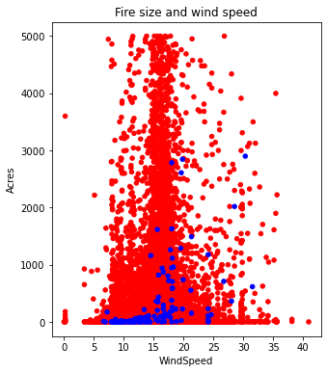
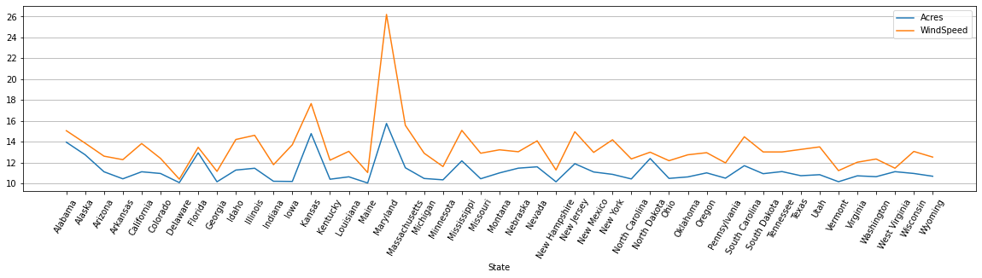
Exploratory Data Analysis
Wildfire Size and Wind Speed
The line graph shows a strong correlation between average wind speeds and the size of fires for each country.
In the scatter plot we can see that most large scale wildfires started at windspeeds between 13 to 20 mph.
Conclusion:
Windspeed is a great factor for determining how big a fire will get. Moderate windspeeds are best for fire growth.
Notes:
Indicator

Slide 15
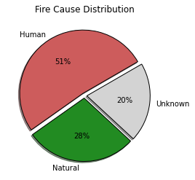
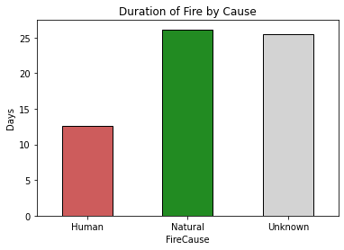
Exploratory Data Analysis
Cause and Duration of Wildfire
The pie chart shows the distribution of what started the wildfire
The bar graph shows the average time it takes to take out a fire depending on the reason it started. ‘Unknown’ bar is for wildfires that their root cause was never determined.
Conclusion: Most humans call the fire department if the fire they started got out of hand, so the wildfire is being treated earlier.

Slide 16
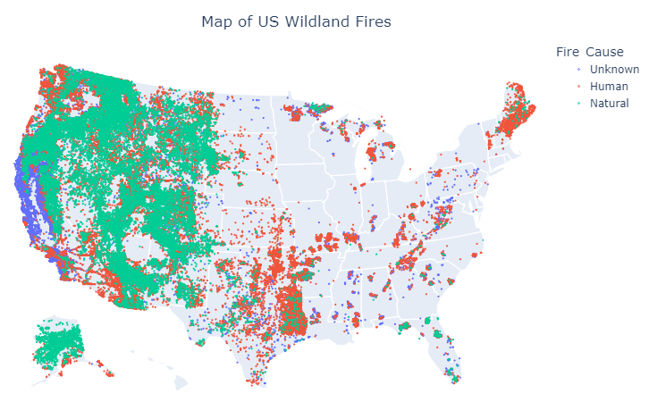
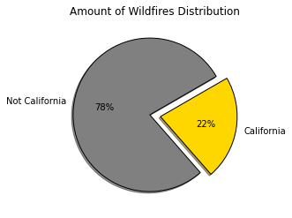
Exploratory Data Analysis
Cause and Location of Wildfire
The map shows that most natural wildfires occur in the west, while the east consists of mostly human ignited wildfires.
California has the highest amount of wildfires out of any state. That’s due to drought, climate change and unsupervised forests. They do not always check for what caused the fires because of the overwhelming amount of them which occur.

Slide 17
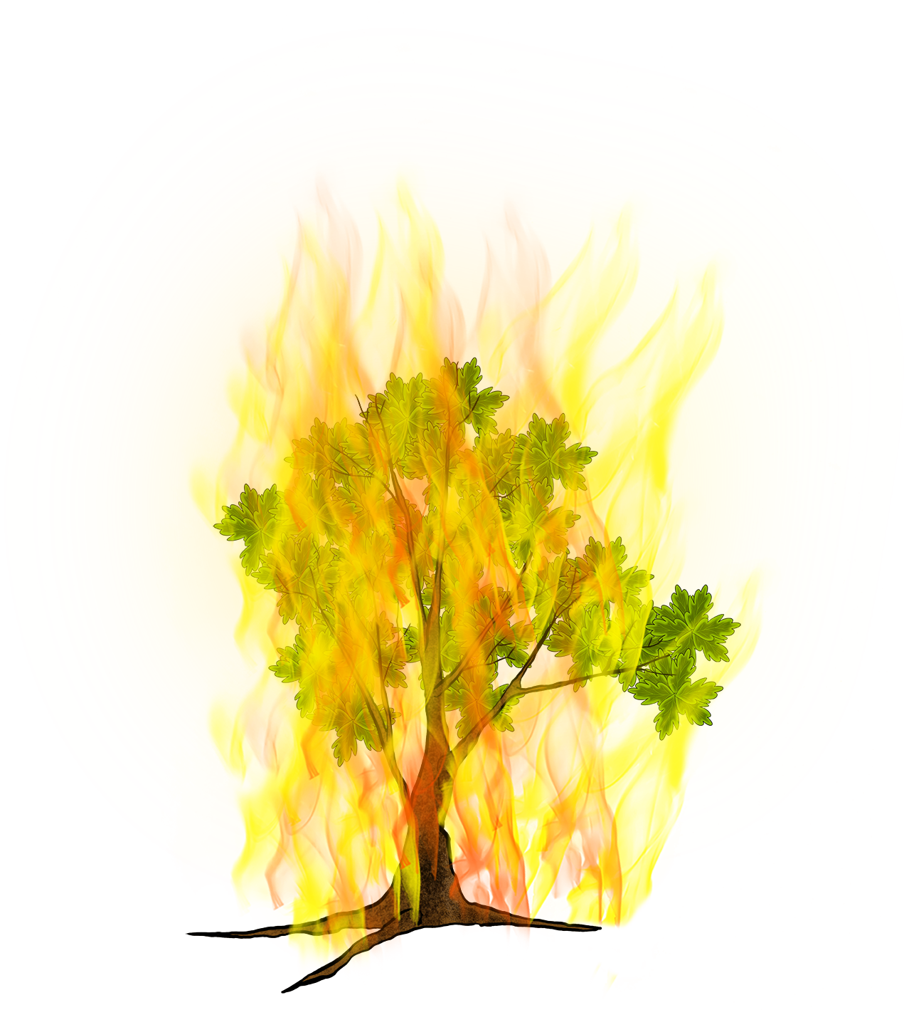

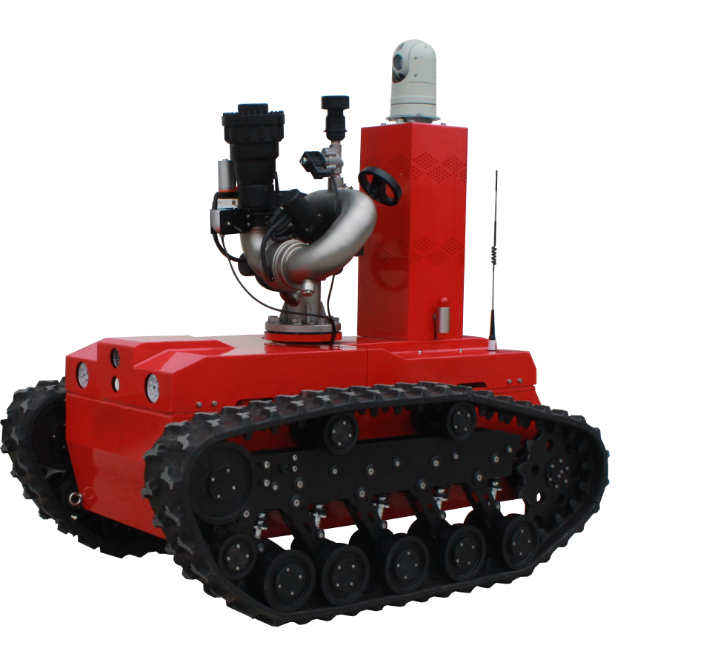
Machine Learning
We use Weather API to get the weather forecast at a given location. The models use that data to predict outcomes.

Slide 18
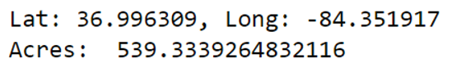
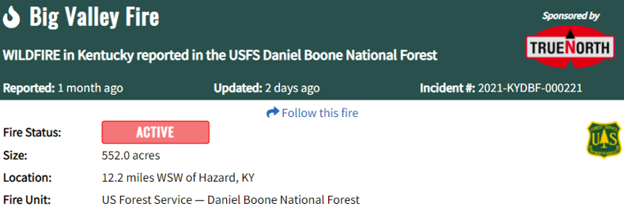
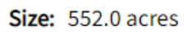
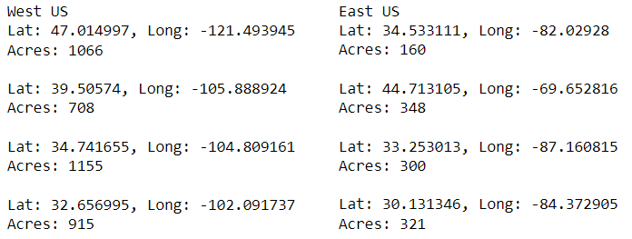
Machine Learning
This is an active fire in Kentucky, which the model predicted with a very accurate size
Linear Regression
Using Linear Regression we were able to predict the potential size of a wildfire in a given location.
Conclusion:
Wildfires in the west are predicted to be larger in size than the wildfires in the east for the upcoming week.
Source
Notes:
For example, this is an active fire in Kentucky:
Underline potential size

Slide 19
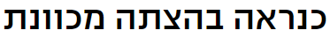
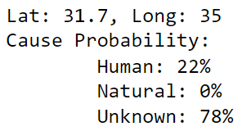
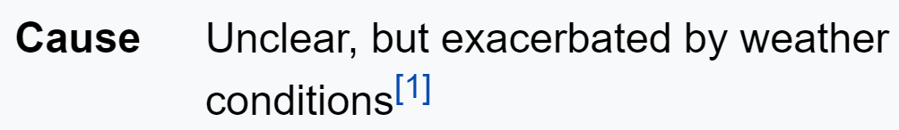
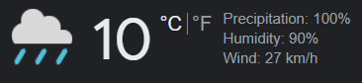
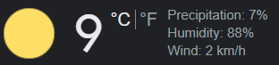
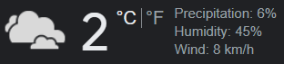
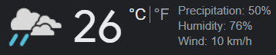
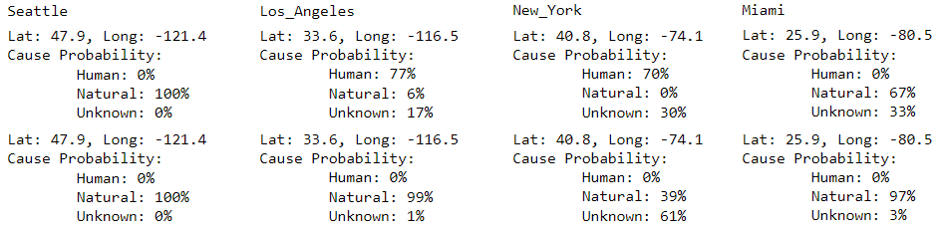
Machine Learning
Jerusalem Forest Wildfire – 08/2022
Logistic Regression
Using Logistic Regression we were able to determine the cause of a wildfire in a given location.
Conclusion:
Wildfires have a higher chance to be ignited by natural causes when there is a higher chance for precipitation.
This can result in a dry thunderstorm that produces lightning, which is the biggest cause of natural wildfires.
Short Duration
Wildfires
Long Duration Wildfires
----------------------------- ----------------------------- ---------------------------- ----------------------------
Notes:
Underline cause of a wildfire
Higher

Slide 20


Any Questions?
Tiran Spierer
tspierer@gmail.com
Ben Israel Siton
bensiton69@gmail.com

Slide 21

Sources and Credits

